Slide 1
Starting MATLAB
Wenbo ZHANG
School of Science, BUPT
zhangwb_wk@163.com

Slide 2
References
Online documents of MatLab
MatLab Help
MatLab Demo

Slide 3
Organization
Two projects
Two defenses
Two reports
Place: RB-120
Time: 13:30 to 17:20

Slide 4
To achieve HIGH Score
Total score
(100%)
Project One
(30%)
Project Two
(70%)
Report One
(30%)
Def. 1
(10%)
Report Two
(30%)
Def. 2
(30%)
Find a good team (3 to 5)
Generate report and slides carefully and clearly
Hand in your report and slides on time
Well organized slides in DEFENSE

Slide 5
Calendar
Sun | Mon | Tue | Wen | Thr | Fri | Sat
 | Jul. 4 | Jul. 5 | Jul. 6 | Jul. 7 | Jul. 8 | Jul. 9
 | P1 & Introduction | P1 | P1 & Deadline 1 | Def. 1
Jul. 10 | Jul. 11 | Jul. 12 | Jul. 13 | Jul. 14 | Jul. 15 | Jul. 16
 | P2 & Introduction | P2 | P2 & Deadline 2 | Def. 2

Slide 6
Notes
One Defense 40%, 10% for the 1st and 30% for the 2nd
  Scores of student of other group (50%)
  Scores of teacher (50%)
Two Reports 60%, 30% for each
  Scores of student of the team (50%)
  Scores of teacher (50%)
Email: zhangwb_wk@163.com
Subject: [2016MatLab]-[Std. No.]-[Name]-[#]
  Copy the SUBJECT and replace info. of Std. No., Name and #;
  Pack your programs, report and PPT slides into a zip file;
  Mail the zip file as an attachment.
Deadline:
  Jul. 6, 24:00, 2016
  Jul. 13, 24:00, 2016

Slide 7
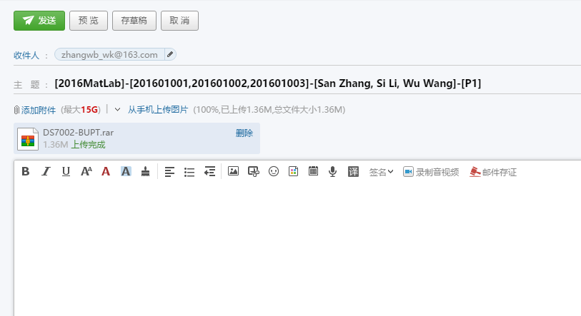

Example of Mail
Subject
Email Add.
Zip file

Slide 8
About Projects
[P1]: A 3D Heart
  basic syntax, data representation, script file
  visualization data
  generating a report (in Chinese or English)
  other skills
[P2]: A Model of Communication System
  basic concepts in communication system
  programming by MatLab or using SimuLink
  generating a report (in Chinese or English)
  other skills
[P2*]:Open topics about data analysis (extra 20% up)
  basic concepts of data analysis
  algorithms, programming by MatLab or SimuLink
  generating a report (in Chinese or English)
  other skills

Slide 9
[P1] Requirements
can draw a 3D heart and explain each command line (60%)
append at least two effects to the heart, such as materials, lights, and so on (70%)
make an animation by using the heart (80%)
make a good sense (100%)

Slide 10
[P2] Requirements
can build a sampler and use figure to show results (60%)
generate an analog signal and sample by using the sampler (70%)
build a simple communication system (80%)
analysis the perform of the system (100%)

Slide 11
[P2*] Requirements
can use figure to show relations between data (60%)
generate model to describe the data (70%)
use mathematical/computer algorithm (80%)
has clear result and deep analysis (100%)

Slide 12
About Defenses
Each team has three to five students
Act as a Defender (each team has one defender)
  To introduce the work had been done
  To defense for results
Free for all students to ask questions
Each team have 5 mins

Slide 13
Topics
Pre-knowledge: Linear Algebra
Part I: The First Step to MatLab
Part II: View Data by Figure
Part III: Programming
Part IV: Data Analysis

Slide 14
YOU HAVE TO REMEMBER ME OR SKILLS WE NEED

Slide 15
GOOD LUCK

